Slide 1
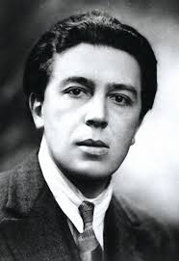
ROBERT
DELAUNAY

Slide 2
A LIFE IN COLOURS

Slide 3
CIRCLES
BIG SMALL

Slide 4
FRANCE
12TH APRIL 1885 - 25TH OCTOBER 1941

Slide 5
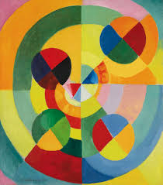

Slide 6
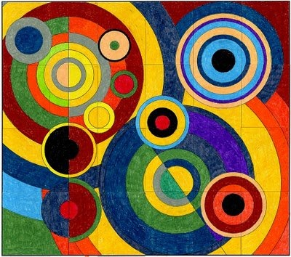

Slide 7
